Slide 1
AUST-Website
A Web Application

Slide 2
PRESENTED BY
Kumkum Chowdhury 14.02.04.002
Siraj Uz Salehin 14.02.04.019
Syed Sajid Mahboob 14.02.04.010
Ashraful Zaman Eashan 13.02.04.098

Slide 3
SUPERVISED BY
Mr. Mohammad Moinul Hoque
Associate Professor
Department of Computer Science and Engineering
Ahsanullah University of Science and Technology

Slide 4
Web Application
A Web application is a software program
Resides on a remote location
Is delivered to the user of the software over the Internet through a web-browser application interface.
can access all the facilities of the application over Internet and also modify the content of any particular site remotely.

Slide 5
OBJECTIVES
Dynamic contents and well structured database
User friendly UI / UX
Make the system state of the art
Making the best use of up to date technologies
Taking the current website to a new level

Slide 6
MOTIVATION
As we are developing a web application, we had chosen our university website. And the following reasons were working behind the motivation.
The current website is unable to deliver proper information to the user
The current website’s security system is vulnerable
AUST current website’s user interface is backdated
The current website system doesn’t have the ability to compete with the trend

Slide 7
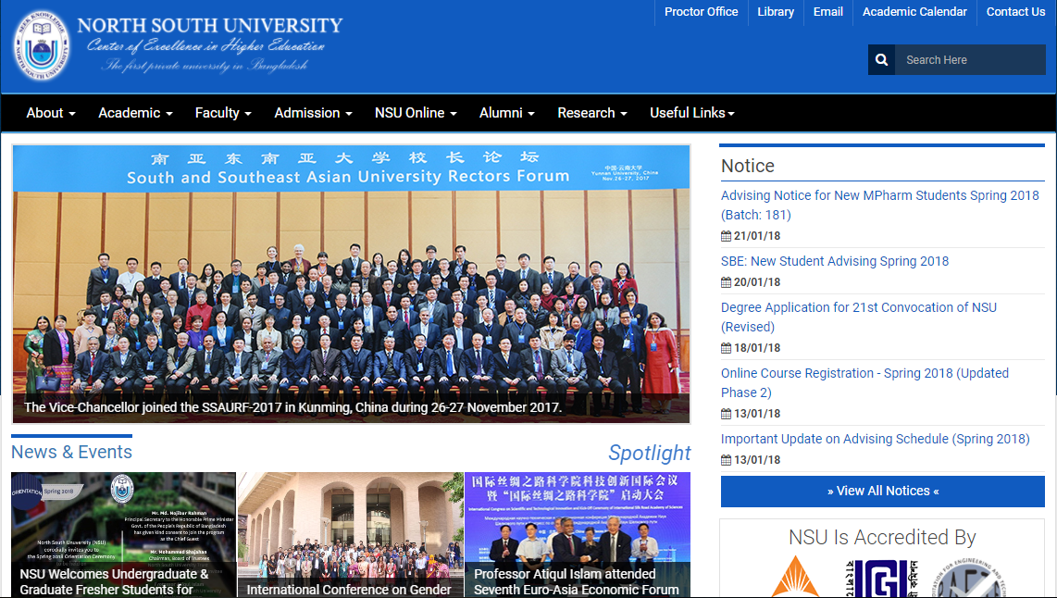
Requirement Analysis
Background Studies
University Name: North South University Reference link : http://www.northsouth.edu/
Used technologies:
OWL Carousel
MODX
Jquery
Modernizr
PHP
Bootstrap
Animate.css
Fancy Box
Font Awesome

Slide 8
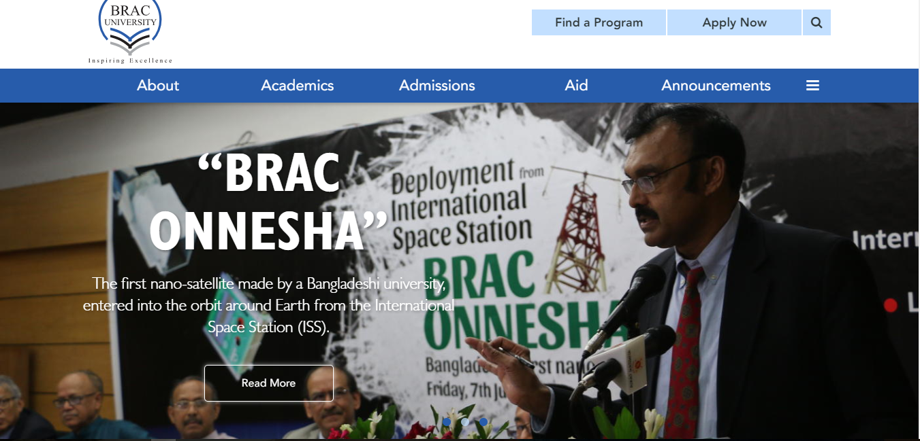
Used Technology of well known universities (contd..):
University Name: Brac University Reference link : http://www.bracu.ac.bd/
Used technologies:
Drupal
Zurb Foundation
PHP
CentOS
ShareThis
Apache
YouTube

Slide 9
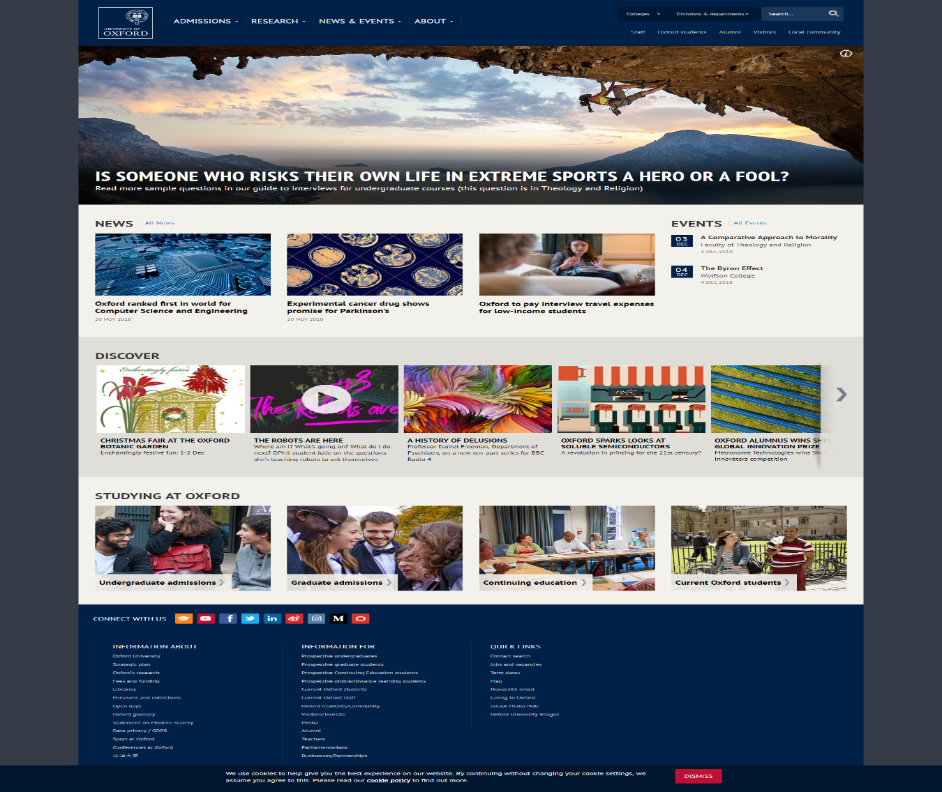
Used Technology in foreign universities:
University Name: Oxford University Reference link : http://www.ox.ac.uk/
Used technologies:
Drupal
Google Tag manager
PHP
Google Font API
Varnish
Apache
YouTube

Slide 10
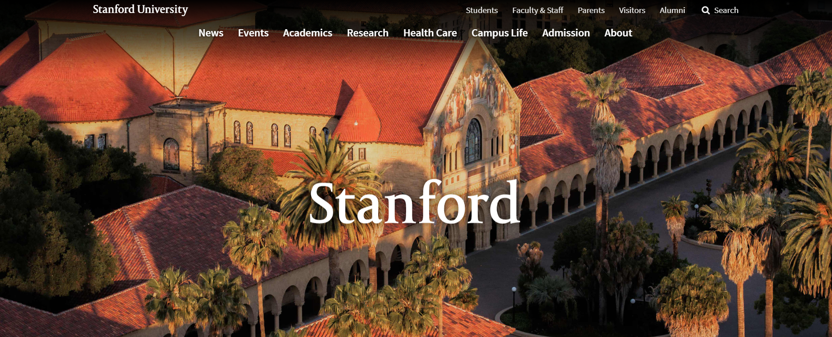
Used Technology in foreign universities (contd..):
University Name: Stanford University Reference link : https://www.stanford.edu/
Used technologies:
Nginx
Wordpress
PHP
Google Analytics
Amazon Cloudfront
modernizr
Jquery
Google Font API

Slide 11
Existing system’s lacking
Design alignments.
Security issues.
Not device friendly GUI.
Unorganized news and events.
Unorganized faculty corner.
Unorganized alumni corner.
Lacking of features in faculty side.
Design is not eye attracting.
No use of templates.
Backend developing issues.
Down of servers while developing or changing somethings.
No dynamic contents.

Slide 12
Features
Advanced Filtering
Dynamic Content
Responsive Mobile UI
Organized Admin Panel
Achievements
Sticky Top Nav-bar
Convocation
News Feed
Activities & Upcoming Events
Teachers' Information
Admission Information
Alumni Corner

Slide 13
PLATFORMS
Front & Back End
HTML 5
CSS 3
JavaScript
Bootstrap
Laravel
JQuery
Database
MySQL

Slide 14
PLATFORMS
UI/UX DESIGN
Sketch
Adobe XD
IDE
Atom

Slide 15
Relational Model Diagram

Slide 16
Live Project Demonstration

Slide 17
Future Plan
Research option will be added with proper and authenticated information.
Collect a vast number of information to make the system more effective
Template based pages where the templates can be chosen
Dynamic design content like color change, design change using dashboard.

